Slide 1
Bootstrapping for Approximate Homomorphic Encryption
ACLab Seungbum Ha

Slide 2
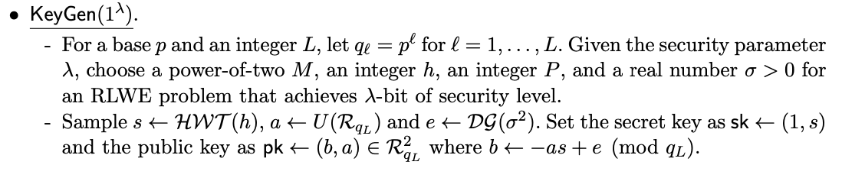

Preliminaries
For a $n_{1} × m$ matrix $A_{1}$ and a $n_{2} × m$ matrix $A_{2}, (A_{1};A_{2})$ denotes the $\left(n_{1}+n_{2}\right) × m$ matrix obtained by concatenating matrices $A_{1}$ and $A_{2}$ in a vertical direction.

Slide 3
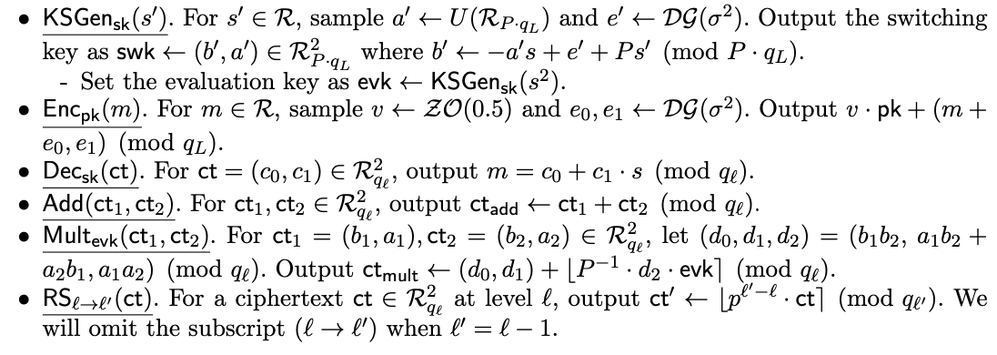
Preliminaries

Slide 4
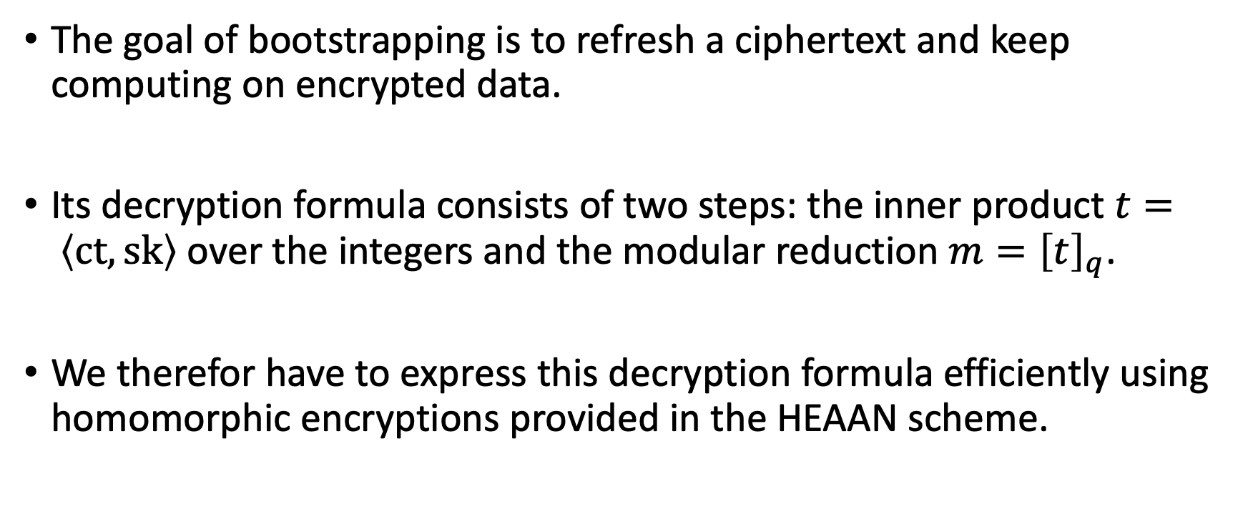
Decryption Formula over the Integers
The goal of bootstrapping is to refresh a ciphertext and keep computing on encrypted data.
Its decryption formula consists of two steps: the inner product $t= \left\langle ct,sk\right\rangle$ over the integers and the modular reduction $m={\left[t\right]}_{q}$.
We therefor have to express this decryption formula efficiently using homomorphic encryptions provided in the HEAAN scheme.

Slide 5
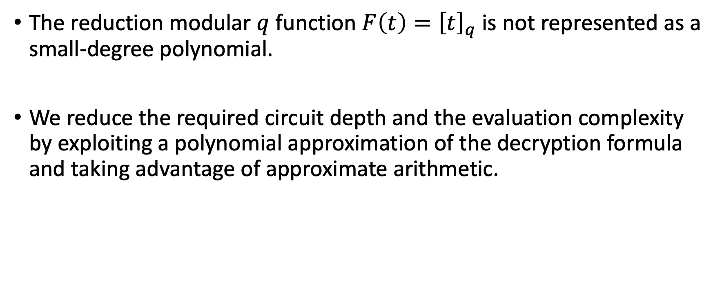
Decryption Formula over the Integers
The reduction modular $q$ function $F\left(t\right)={\left[t\right]}_{q}$ is not represented as a small-degree polynomial.
We reduce the required circuit depth and the evaluation complexity by exploiting a polynomial approximation of the decryption formula and taking advantage of approximate arithmetic.
Notes:
F(t) 함수에 단순히 다항식 보간(?)을 하면 파라미터 크기나 컴퓨팅 코스트가 너무 커지게 된다.
반올림 연산의 장점을 활용하여 서킷의 뎁스와 evaluation 복잡도를 낮추었다.

Slide 6
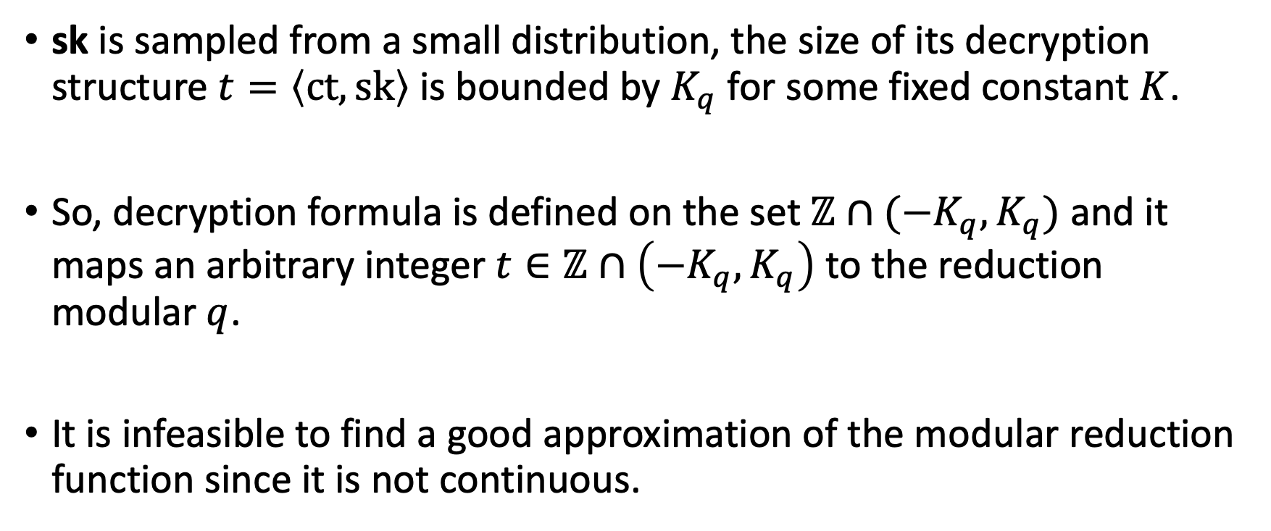
Approximation of the Modular Reduction Function
sk is sampled from a small distribution, the size of its decryption structure $t=\left\langle ct,sk\right\rangle$ is bounded by $K_{q}$ for some fixed constant $K$.
So, decryption formula is defined on the set $ℤ∩(−K_{q},K_{q})$ and it maps an arbitrary integer $t∈ℤ∩\left(−K_{q},K_{q}\right)$ to the reduction modular $q$.
It is infeasible to find a good approximation of the modular reduction function since it is not continuous.

Slide 7
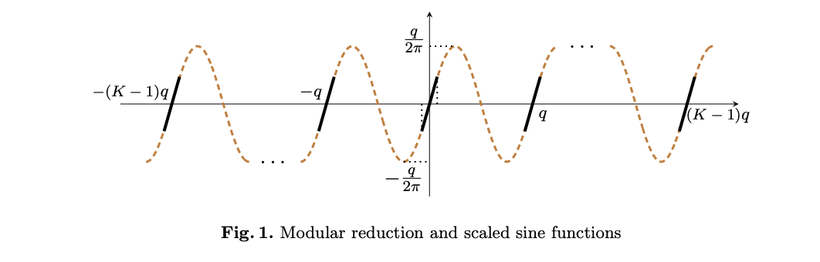
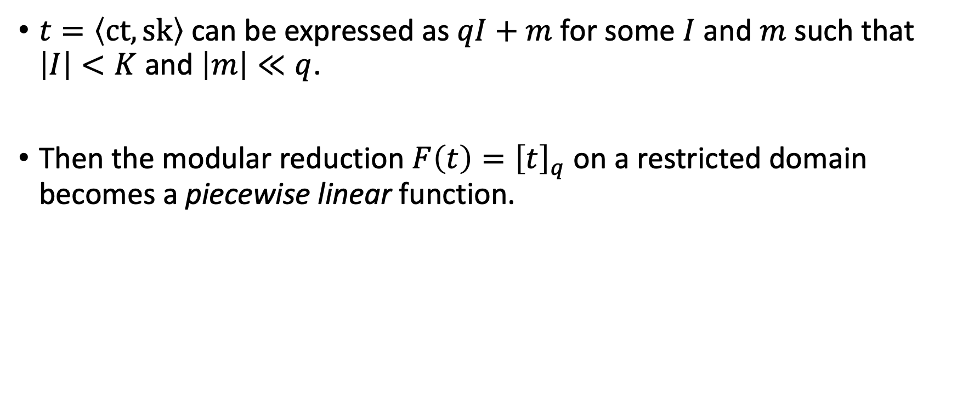
Approximation of the Modular Reduction Function
$t=\left\langle ct,sk\right\rangle$ can be expressed as $qI+m$ for some $I$ and $m$ such that $\left|I\right|<K$ and $\left|m\right|≪q$.
Then the modular reduction $F\left(t\right)={\left[t\right]}_{q}$ on a restricted domain becomes a piecewise linear function.
Notes:
메시지 m이 여전히 modulus q 보다 훨씬 작다고 가정하자.
그리고 I는 아까 정한 K보다 작다고 가정한다.
이 가정은 reasonable 하다. 왜냐하면 암호문의 모듈러스가 너무 작아지기 전에 bootstrapping을 시작할 수 있기 때문이다.

Slide 8
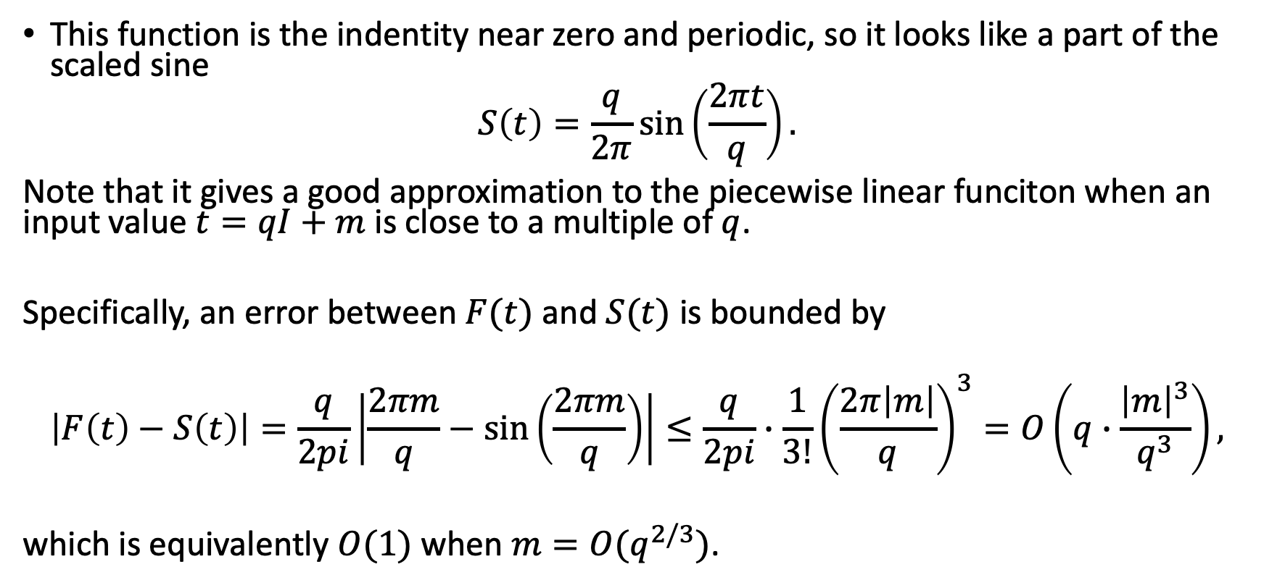
Approximation of the Modular Reduction Function
This function is the indentity near zero and periodic, so it looks like a part of the scaled sine
$$S\left(t\right)=\frac{q}{2π}\sin\left(\frac{2πt}{q}\right).$$
Note that it gives a good approximation to the piecewise linear funciton when an input value $t=qI+m$ is close to a multiple of $q$.
Specifically, an error between $F(t)$ and $S(t)$ is bounded by
$$\left|F\left(t\right)−S\left(t\right)\right|=\frac{q}{2pi}\left|\frac{2πm}{q}−\sin\left(\frac{2πm}{q}\right)\right|≤\frac{q}{2pi}∙\frac{1}{3!}{\left(\frac{2π\left|m\right|}{q}\right)}^{3}=O\left(q∙\frac{{\left|m\right|}^{3}}{q^{3}}\right),$$
which is equivalently $O(1)$ when $m=O(q^{2/3})$.
Notes:
메시지 m이 여전히 modulus q 보다 훨씬 작다고 가정하자.
그리고 I는 아까 정한 K보다 작다고 가정한다.
이 가정은 reasonable 하다. 왜냐하면 암호문의 모듈러스가 너무 작아지기 전에 bootstrapping을 시작할 수 있기 때문이다.

Slide 9
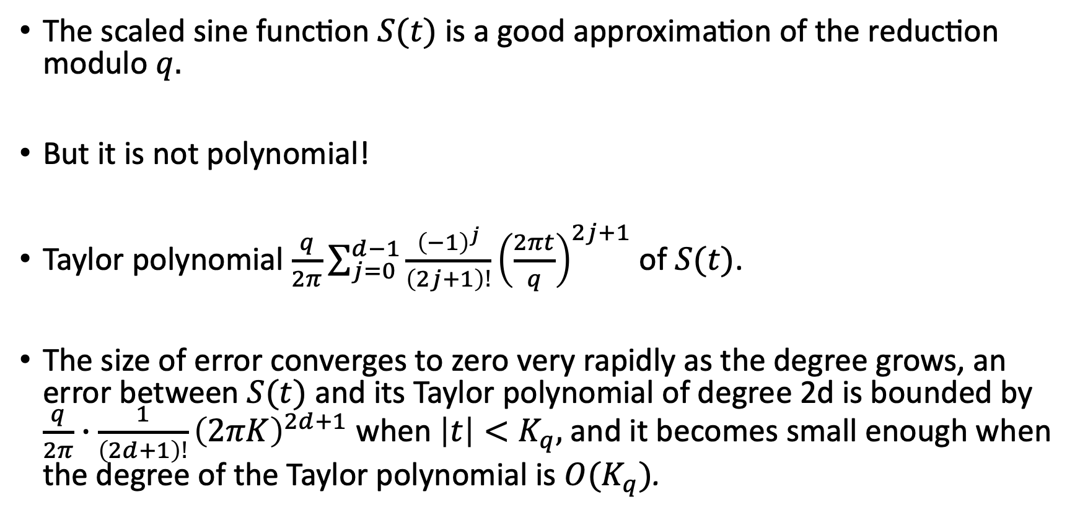
Homomorphic Evaluation of the Complex Exponential Function
The scaled sine function $S(t)$ is a good approximation of the reduction modulo $q.$
But it is not polynomial!
Taylor polynomial $\frac{q}{2π}\sum_{j=0}^{d−1}{\frac{{\left(−1\right)}^{j}}{\left(2j+1\right)!}}{\left(\frac{2πt}{q}\right)}^{2j+1}$ of $S(t)$.
The size of error converges to zero very rapidly as the degree grows, an error between $S(t)$ and its Taylor polynomial of degree 2d is bounded by $\frac{q}{2π}∙\frac{1}{\left(2d+1\right)!}{\left(2πK\right)}^{2d+1}$ when $\left|t\right|<K_{q},$ and it becomes small enough when the degree of the Taylor polynomial is $O(K_{q})$.
Notes:
다항함수가 아니라는 것은 HE 스킴에 바로 사용할 수 없다는 것을 의미한다.
S(t)를 테일러 다항식으로 바꾸면 다음과 같다.
하지만 높은 정확도에도 불구하고, 이 방법은 실용적으로 사용될 수 없다.
Complexity가 circuit의 depth에 따라 지수적으로 증가한다.

Slide 10
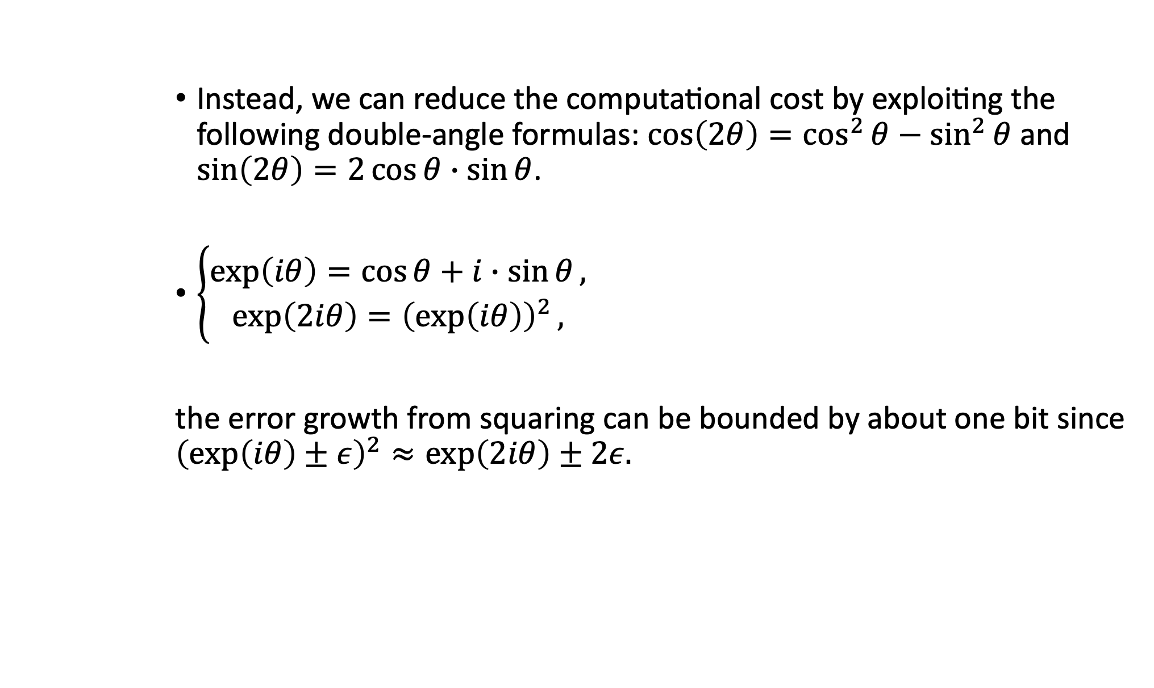
Homomorphic Evaluation of the Complex Exponential Function
Instead, we can reduce the computational cost by exploiting the following double-angle formulas: $\cos\left(2θ\right)=\cos^{2}{θ}−\sin^{2}{θ}$ and $\sin\left(2θ\right)=2\cos{θ}∙\sin{θ}$.
$\left\{\begin{aligned}\exp\left(iθ\right)=\cos{θ}+i∙\sin{θ}, \\ \exp\left(2iθ\right)={\left(\exp\left(iθ\right)\right)}^{2},\end{aligned}\right.$
the error growth from squaring can be bounded by about one bit since ${\left(\exp\left(iθ\right)±ε\right)}^{2}≈\exp\left(2iθ\right)±2ε.$
Notes:
배각공식을 활용해서 삼각함수의 작은 정의역을 확장할 수 있다.
특히, HEAAN 스킴은 복소수를 암호화하기에, evaluation 알고리즘은 복소수 지수 함수를 활용하여 간단(?)해 져야한다.

Slide 11
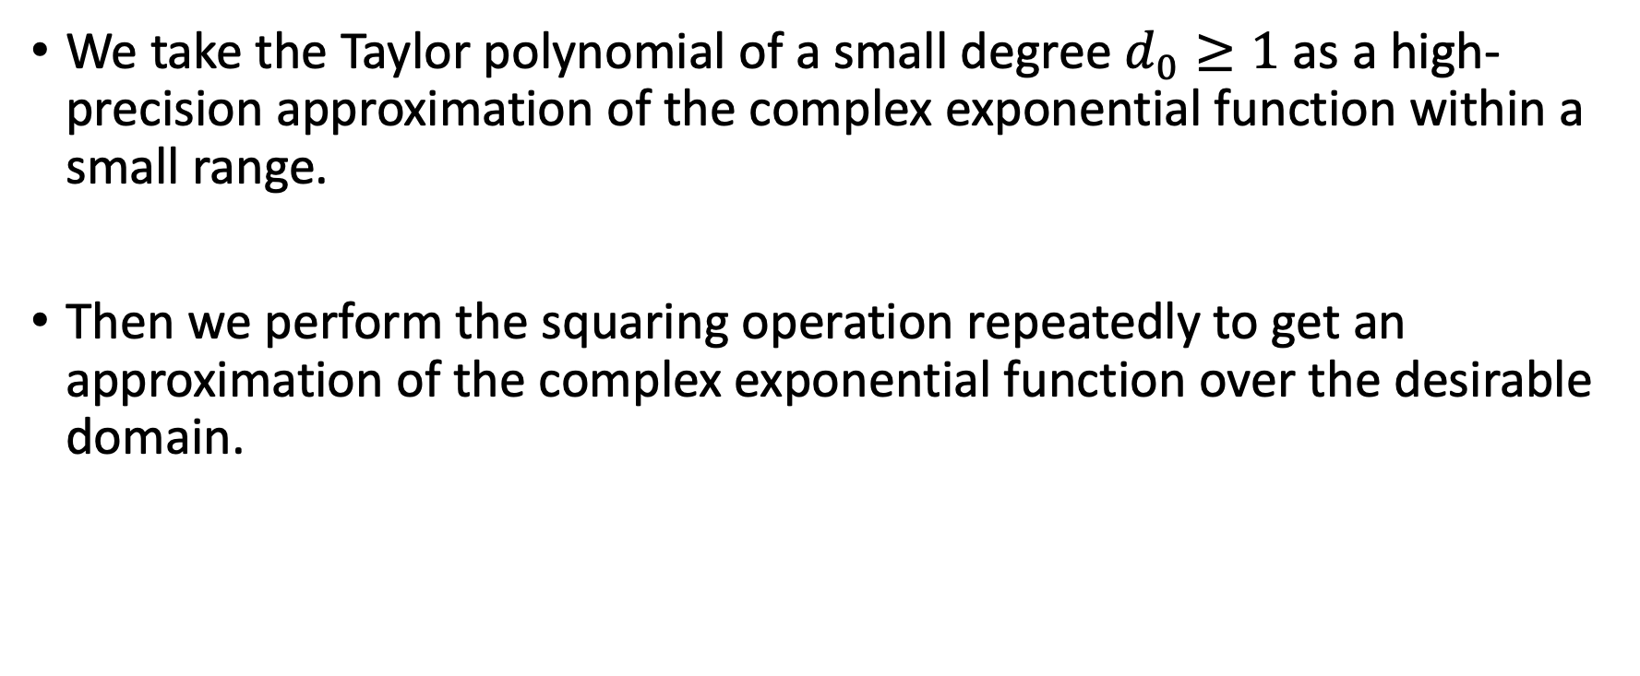
Homomorphic Evaluation of the Complex Exponential Function
We take the Taylor polynomial of a small degree $d_{0}≥1$ as a high-precision approximation of the complex exponential function within a small range.
Then we perform the squaring operation repeatedly to get an approximation of the complex exponential function over the desirable domain.

Slide 12
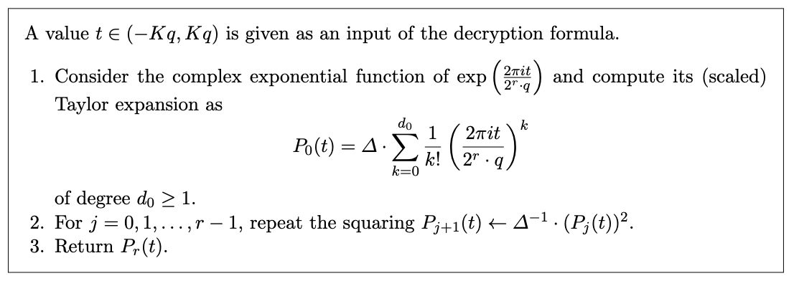

Homomorphic Evaluation of the Complex Exponential Function
The size of the initial input $(2πt)/(2^{r}∙q)$ of the complex exponential function has a small upper bound $(2πK/2^{r})$, even the Taylor polynomial of a small degree $d_{0}$ can be a good approximation to the complex exponential function $\exp{(\frac{2πit}{2^{r}∙q})}.$
Notes:
HEAAN 스킴을 생각하면, encryption, evaluation, rescaling, slot permutation 과정들에 계속 작은 복소수 에러가 추가된다.
즉, decryption formula 는 그 작은 복소수 에러를 수용(?)할 수 있어야 한다는 제한조건 한가지만 있다.

Slide 13
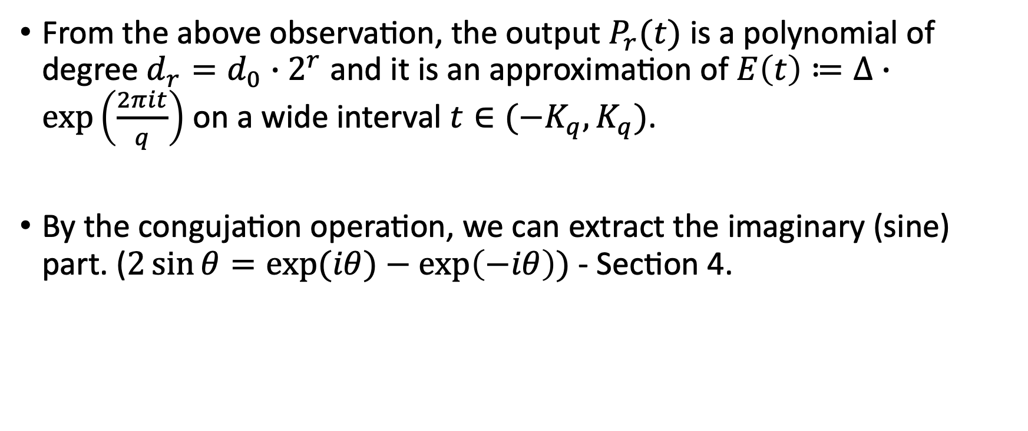
Homomorphic Evaluation of the Complex Exponential Function
From the above observation, the output $P_{r}(t)$ is a polynomial of degree $d_{r}=d_{0}∙2^{r}$ and it is an approximation of $E\left(t\right)≔∆∙\exp\left(\frac{2πit}{q}\right)$ on a wide interval $t∈(−K_{q},K_{q})$.
By the congujation operation, we can extract the imaginary (sine) part. ($2\sin{θ}=\exp{(iθ)}−\exp\left(−iθ\right))$ - Section 4.

Slide 14
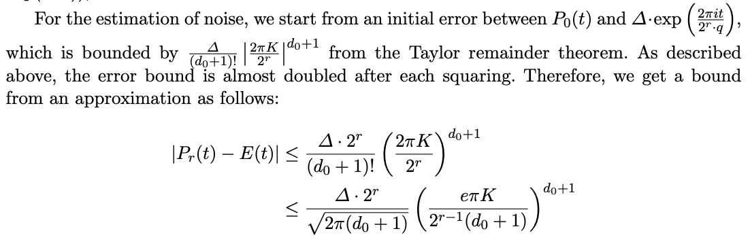
Homomorphic Evaluation of the Complex Exponential Function
Asymptotically the choice of parameters $d_{0}=O\left(1\right)$ and $r=O\left(\log\left(K_{q}\right)\right)$ gives us a sufficiently small error bound.
Notes:
스털링의 공식으로부터..??

Slide 15
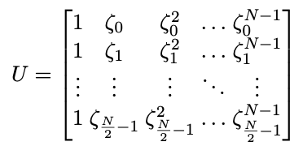
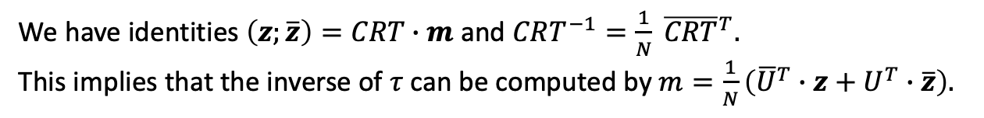
Packing Method
We have identities $\left(z;\overline{z}\right)=CRT∙m$ and $CRT^{−1}=\frac{1}{N} {\overline{CRT}}^{T}.$
This implies that the inverse of $τ$ can be computed by $m=\frac{1}{N}\left({\overline{U}}^{T}∙z+U^{T}∙\overline{z}\right).$

Slide 16
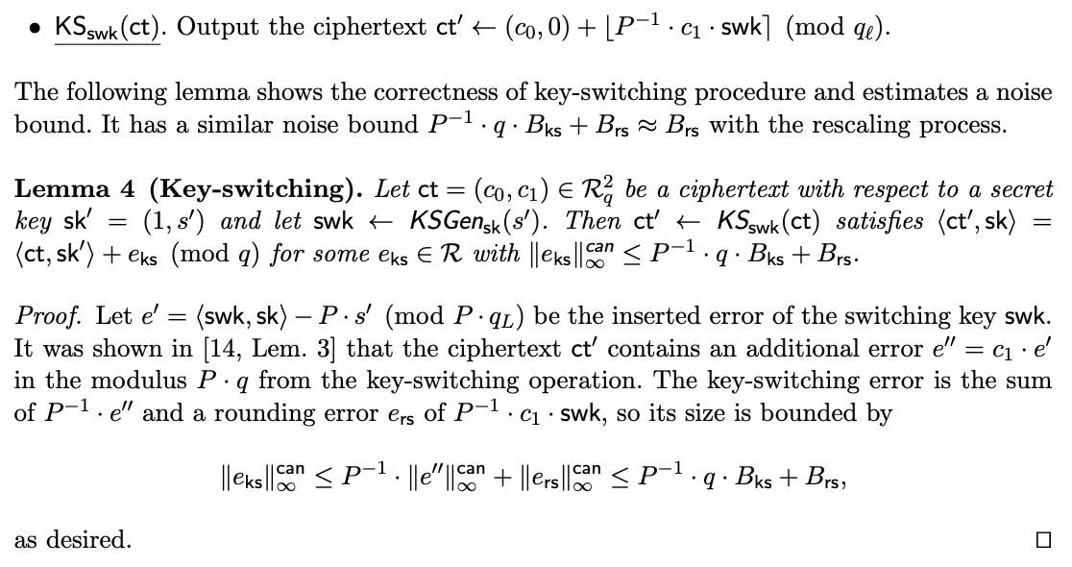
Key-switching
Notes:
이 내용 밑에는 slot permuation 에 대해서 적혀있는듯?

Slide 17
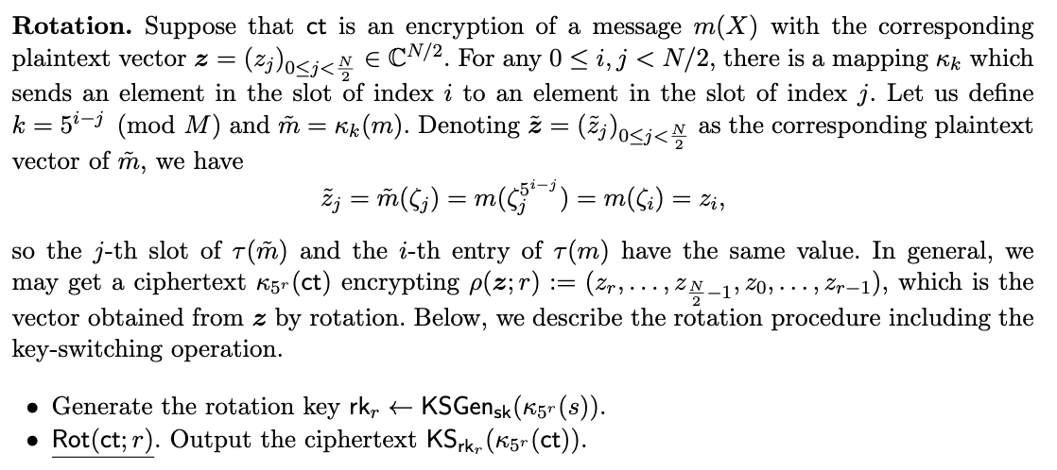
Rotation and Conjugation

Slide 18
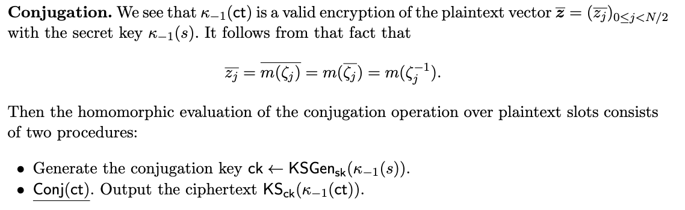
Rotation and Conjugation

Slide 19

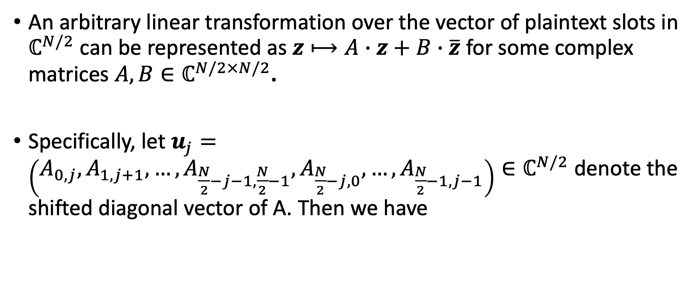
Linear Transformations
An arbitrary linear transformation over the vector of plaintext slots in $ℂ^{N/2}$ can be represented as $z⟼A∙z+B∙\overline{z}$ for some complex matrices $A,B∈ℂ^{N/2×N/2}$.
Specifically, let $u_{j}=\left(A_{0,j},A_{1,j+1},…,A_{\frac{N}{2}−j−1,\frac{N}{2}−1},A_{\frac{N}{2}−j,0},…,A_{\frac{N}{2}−1,j−1}\right)∈ℂ^{N/2}$ denote the shifted diagonal vector of A. Then we have
Notes:
행렬-벡터 곱연산 A-z는 로테이션의 조합과 스칼라 곱으로 표현된다.
P(z;j)는 ct와 j의 로테이션으로 동형 연산될 수 있고, Hadamard 스칼라 곱은 타우-1(uj)의 곱으로 행해질 수 있다.

Slide 20
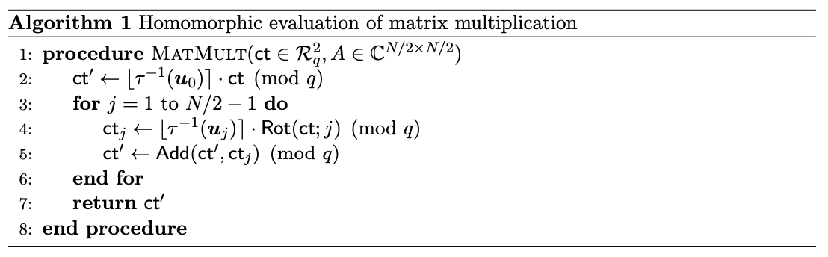
Linear Transformations
Similarly, the second term $B∙\overline{z}$ can be obtained by multiplying the matrix $B$ after applying the slot-wise conjugation on $z.$
Notes:
이 알고리즘은 N/2-1번의 로테이션과 N 번의 곱셈을 요구한다. 하지만 Baby-step Giant-step 알고리즘으로 복잡도를 낮출 수 있다.

Slide 21
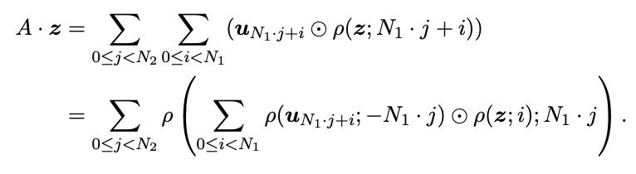
Linear Transformations
Notes:
이때 생기는 에러는 스케일링 팩터로 처리가 가능하다.

Slide 22
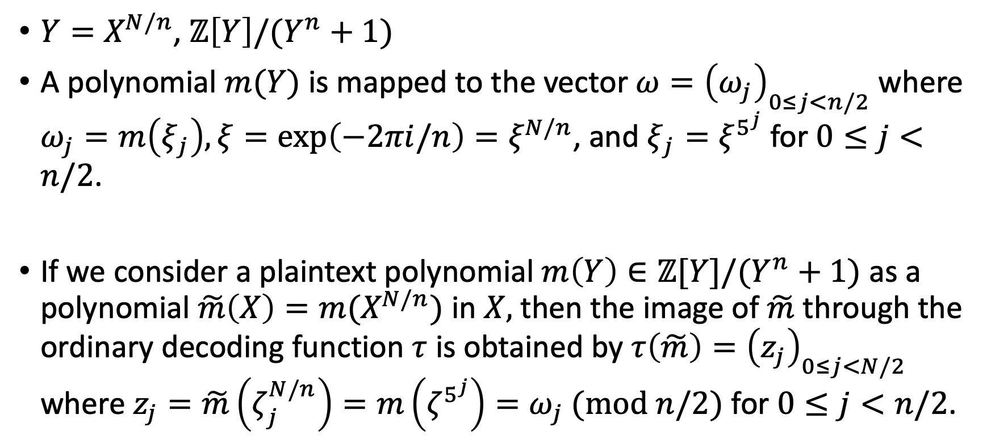
Sparsely Packed Ciphertext
$Y=X^{N/n}$, $ℤ\left[Y\right]/(Y^{n}+1)$
A polynomial $m(Y)$ is mapped to the vector $ω={\left(ω_{j}\right)}_{0≤j<n/2}$ where $ω_{j}=m\left(ξ_{j}\right), ξ=\exp\left(−2πi/n\right)=ξ^{N/n}$, and $ξ_{j}=ξ^{5^{j}}$ for $0≤j<n/2$.
If we consider a plaintext polynomial $m\left(Y\right)∈ℤ[Y]/(Y^{n}+1)$ as a polynomial $\tilde{m}\left(X\right)=m(X^{N/n})$ in $X,$ then the image of $\tilde{m}$ through the ordinary decoding function $τ$ is obtained by $τ\left(\tilde{m}\right)={\left(z_{j}\right)}_{0≤j<N/2}$ where $z_{j}=\tilde{m}\left(ζ_{j}^{N/n}\right)=m\left(ζ^{5^{j}}\right)=ω_{j} (mod n/2)$ for $0≤j<n/2$.

Slide 23
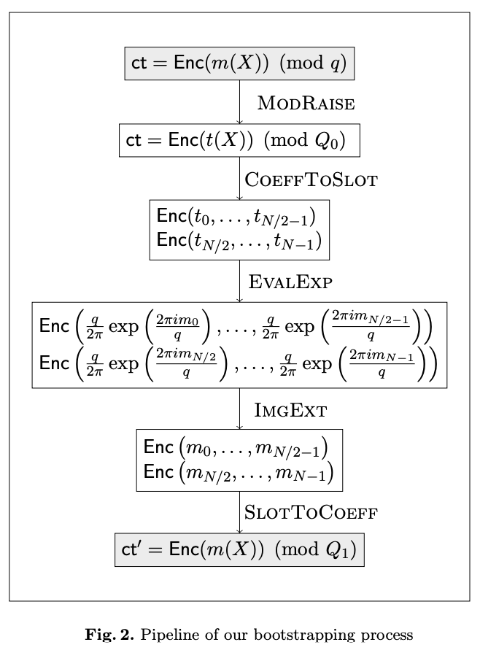
Bootstrapping for HEAAN

Slide 24
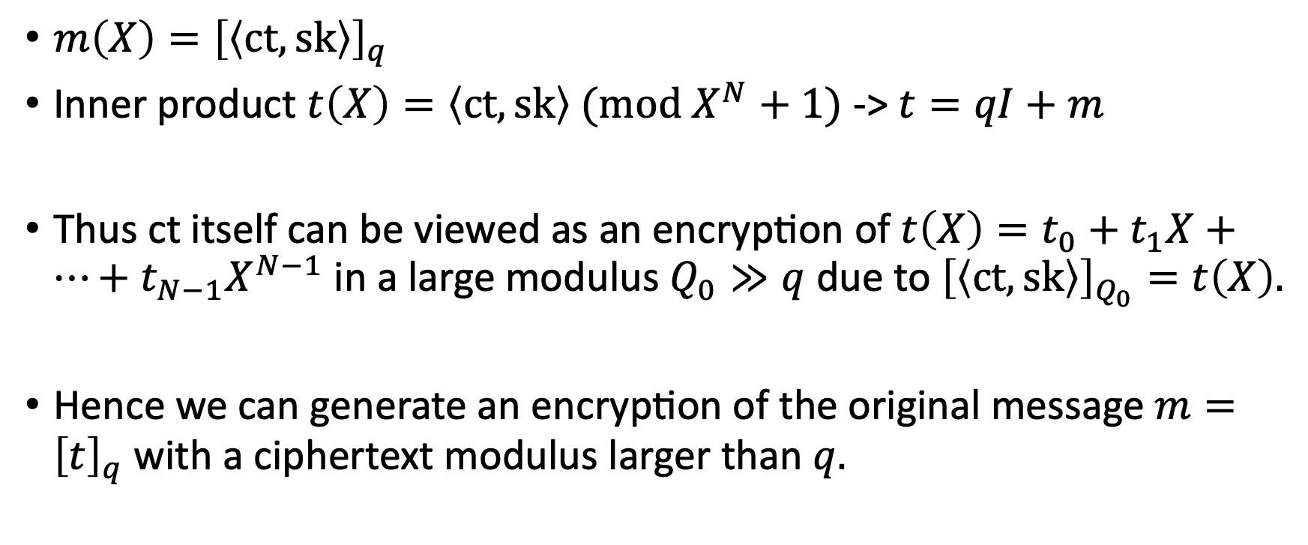

Modulus raising
$$I\left(X\right)∈ℛ, {\left|\left|I\right|\right|}_{∞}<K$$
$m\left(X\right)={\left[\left\langle ct,sk\right\rangle \right]}_{q}$
Inner product $t\left(X\right)=\left\langle ct,sk\right\rangle (mod X^{N}+1)$ -> $t=qI+m$
Thus ct itself can be viewed as an encryption of $t\left(X\right)=t_{0}+t_{1}X+…+t_{N−1}X^{N−1}$ in a large modulus $Q_{0}≫q$ due to ${\left[\left\langle ct,sk\right\rangle \right]}_{Q_{0}}=t\left(X\right).$
Hence we can generate an encryption of the original message $m={\left[t\right]}_{q}$ with a ciphertext modulus larger than $q.$

Slide 25
Putting polynomial coefficients in plaintext slots

